Slide 1


Central Superstore
Data Analysis Report

Slide 2
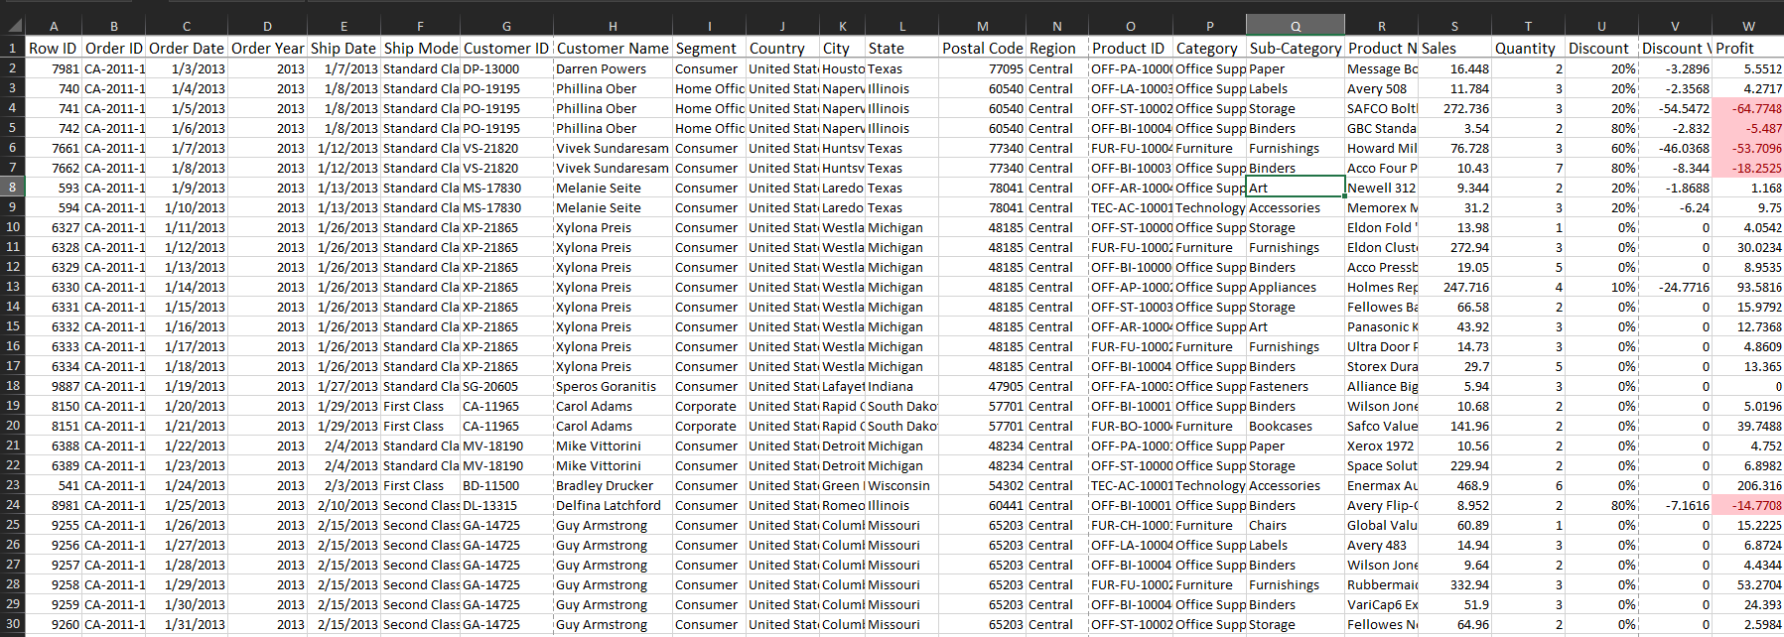
Data Set

Slide 3
Columns
There are many columns in its. The important column we care about as they affect on Sales:
Profit
Sales
Customer
Ship Mode
City

Slide 4


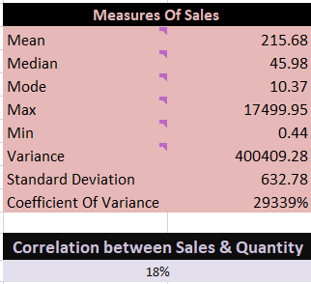
Measures Of Sales

Slide 5
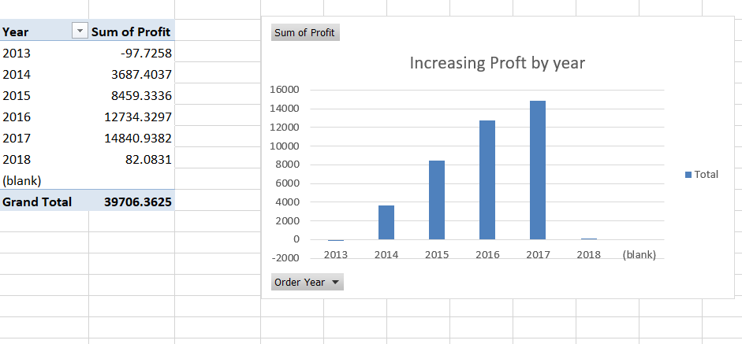
The profit by year

Slide 6
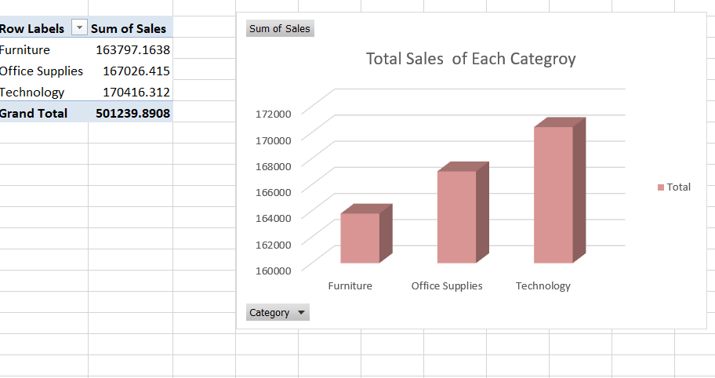
The technology has the biggest sales

Slide 7
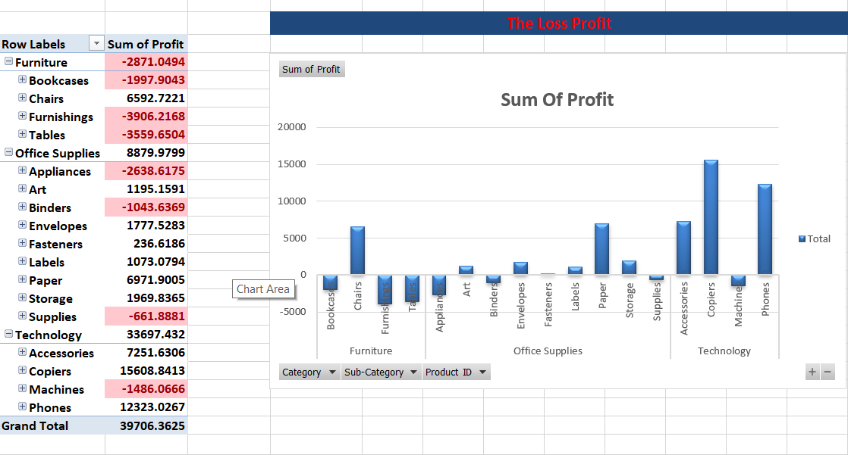
Which Category has loss profit

Slide 8
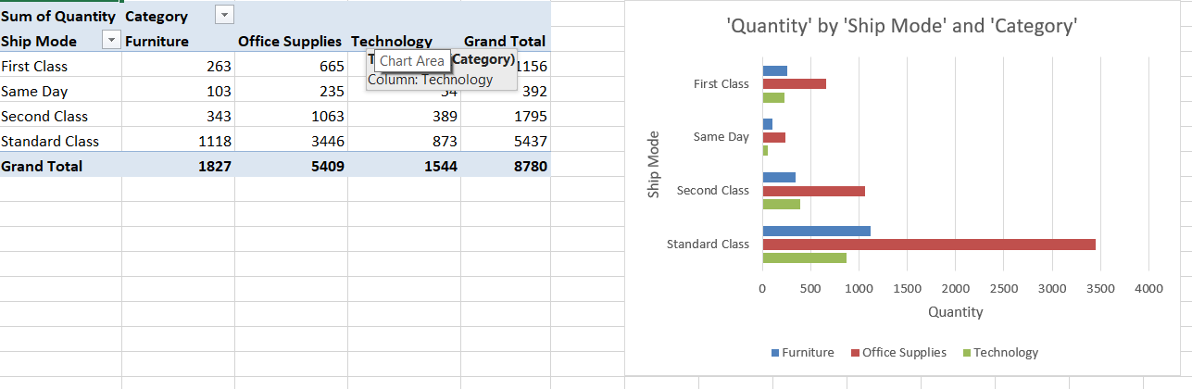
How Ship Mode Affect on the Quantity

Slide 9
